Slide 1
Mashable Online News Popularity

Slide 2
Problem Statement
Here we are trying to attract more clicks/viewers to Mashables by analyzing which category of articles is popular. With that information, are we able to use this to focus and display this popular category to attract more clicks and attention?
We will use machine learning techniques in order to figure this out and predict whether or not the articles will be popular before being published. The number of shares will represent the popularity of the article.

Slide 3
Data
The sample dataset can be accessed from UCI Machine Learning Repository: http://archive.ics.uci.edu/ml/datasets/Online+News+Popularity#
K. Fernandes, P. Vinagre and P. Cortez. A Proactive Intelligent Decision Support System for Predicting the Popularity of Online News. Proceedings of the 17th EPIA 2015 - Portuguese Conference on Artificial Intelligence, September, Coimbra, Portugal.

Slide 4
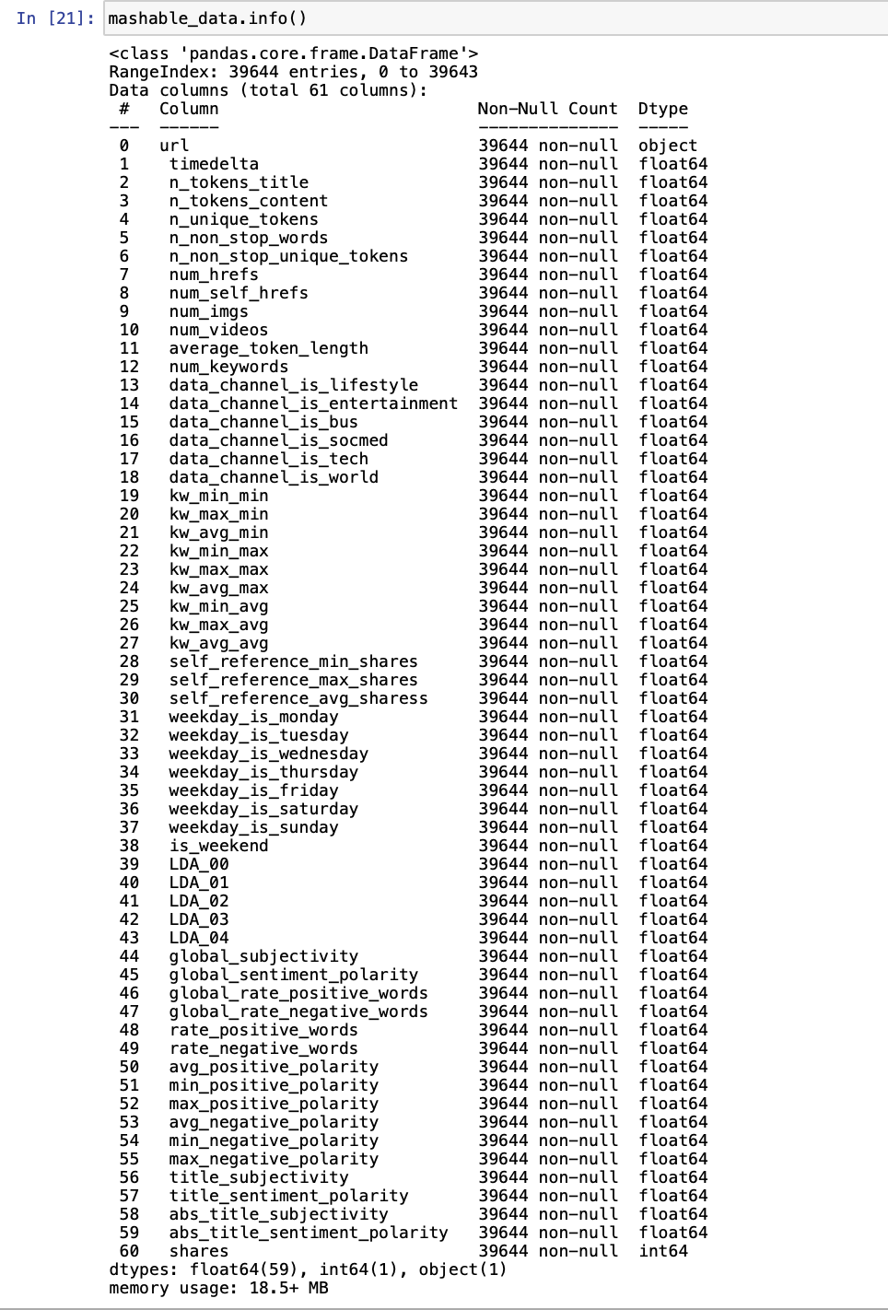
Exploratory Data Analysis (EDA)
Data contains 39644 rows and 61 columns
Float = 59
Object(string) = 1
Integers = 1

Slide 5
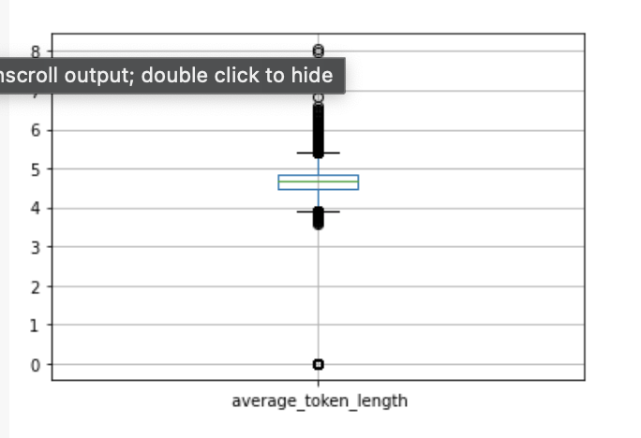
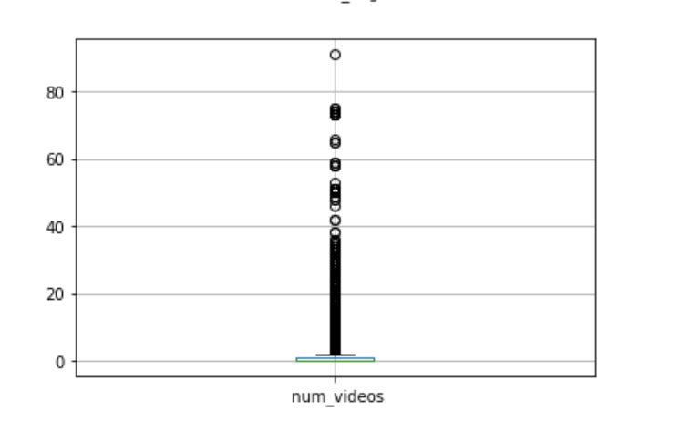
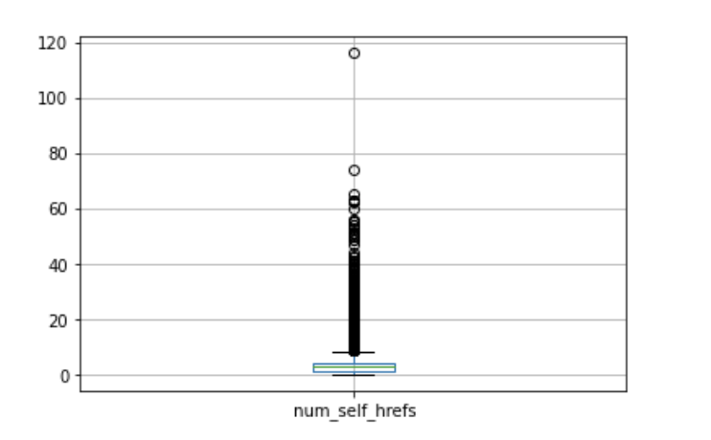
Exploratory Data Analysis
Indicated dataset contains outliers
We used IQR method to remove some of the outliers
Notes:
-outliers create problem with our model
-eliminated as many outliers as possible using the interquartile range method

Slide 6
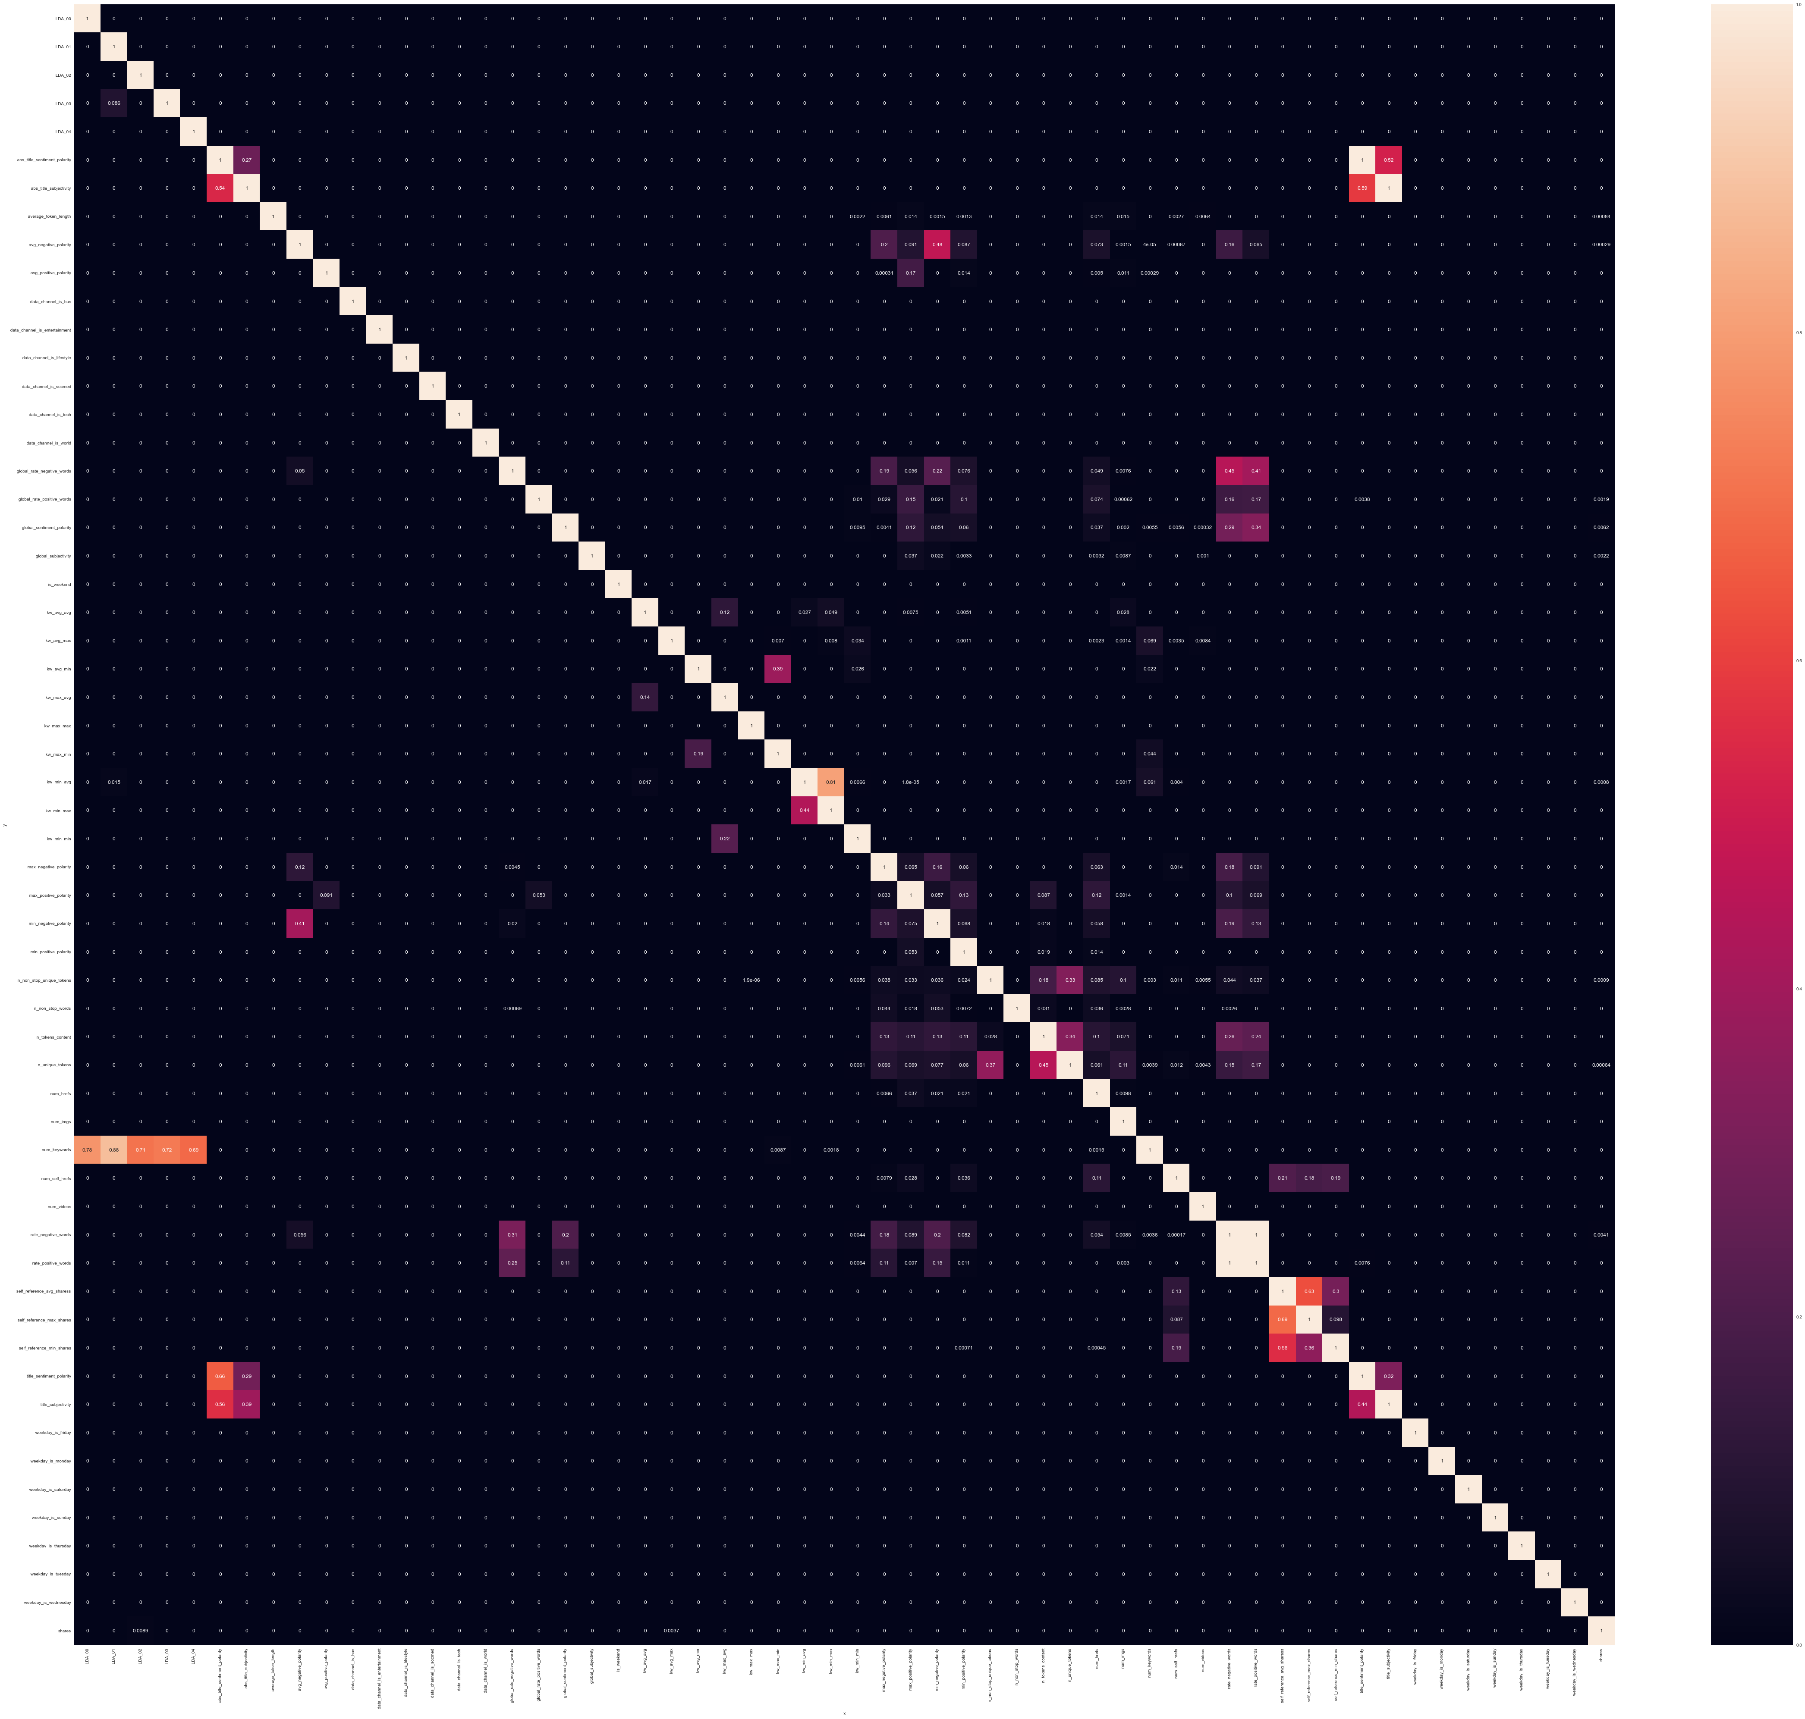
-There are several variables that have high correlations. This meant that they provided similar information that could be repetitive during the prediction of a target variable.
-In regards to the variable shares where numbers are nonzero have some values/or correlated such as: unique_tokens, global_subjectivity
Notes:
Here we can see examples of self_reference_avg_shares, self_reference_max_shares and self_reference_min_shares whose correlations are close to 1.

Slide 7
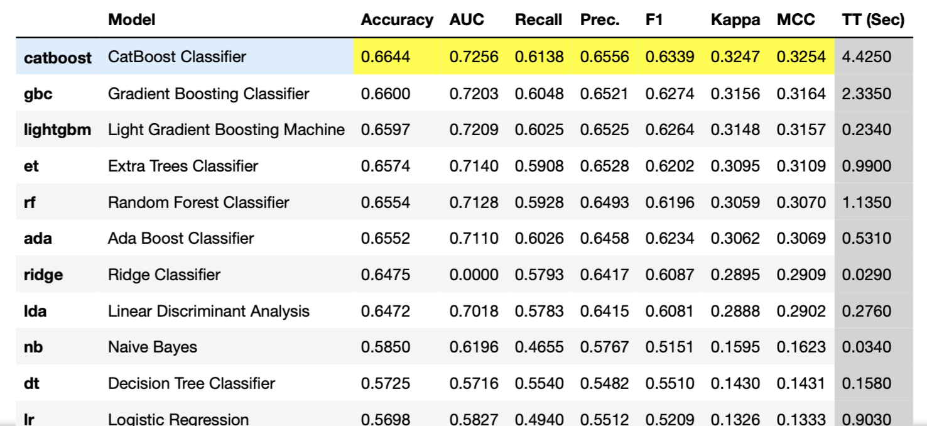
Preprocessing and Modeling
Model to use is the CatBoost Classifier as it shows the highest accuracy of 66.44% than the rest of the models
After tuning the hyperparameters of the CatBoost Classifier model it increases the model by 0.03%
Classification module was used since regression module did not yield satisfying result. The r-square is very low
Pycaret was used to automate the process of finding the best model to use: CatBoost Classifier
Notes:
REDO and add info

Slide 8
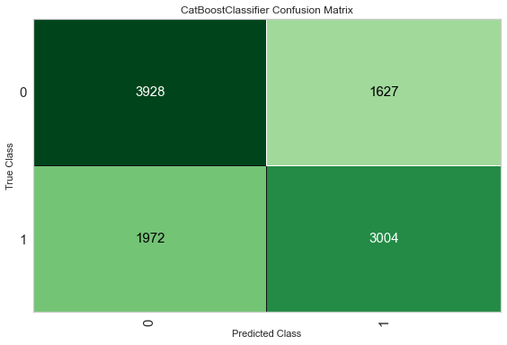
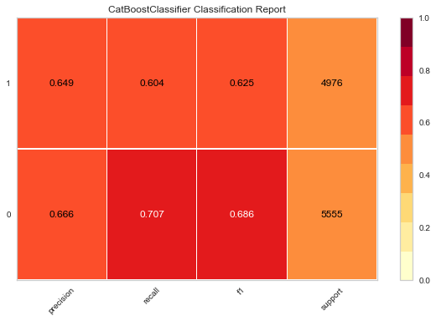
The Confusion Matrix shows the true positives and the true negatives.
0 = unpopular
1 = popular
Algorithm predicted 3928 unpopular shares and 3004 popular shares
The Classification reports show accurately our model predicted. The percentage of both the popular and unpopular shares is shown above 50%, around 60%.

Slide 9
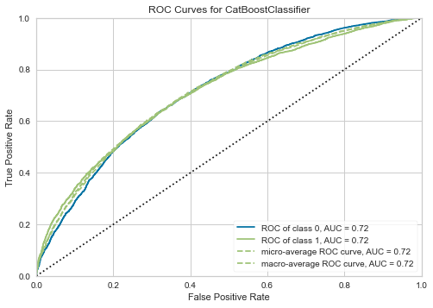
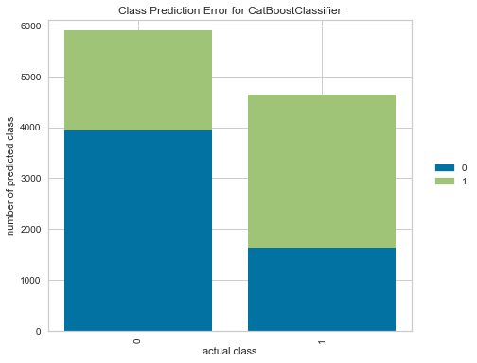
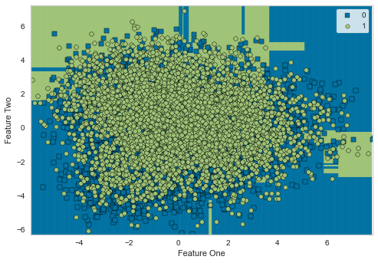
Notes:
-The ROC curves show the model is good because it is above the baseline/dummy model (black dotted lines). Both class 0 and 1 have an AUC of 0.72, which is 0.22 lifted compared to the baseline model.

Slide 10
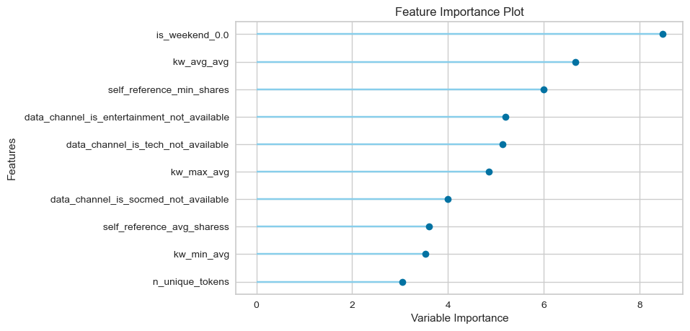
sdfsdf
Notes:
This figure is an important plot for this experiment as it explores the importance of our variables. This is showing that the popular number of shared articles come from the weekend. It also shows us that the categories of articles in entertainment, tech, and social media have the greatest number of shares compared to the others. Lastly, we can see that unique tokens also known as popular keywords are relevant in contributing to the number of shares.

Slide 11
Conclusion
Post more articles on the weekend to increase more viewers
To help articles reach more viewers improve the keyword strength
Focus on popular categories such as entertainment, tech and social media
In fu

